Slide 1
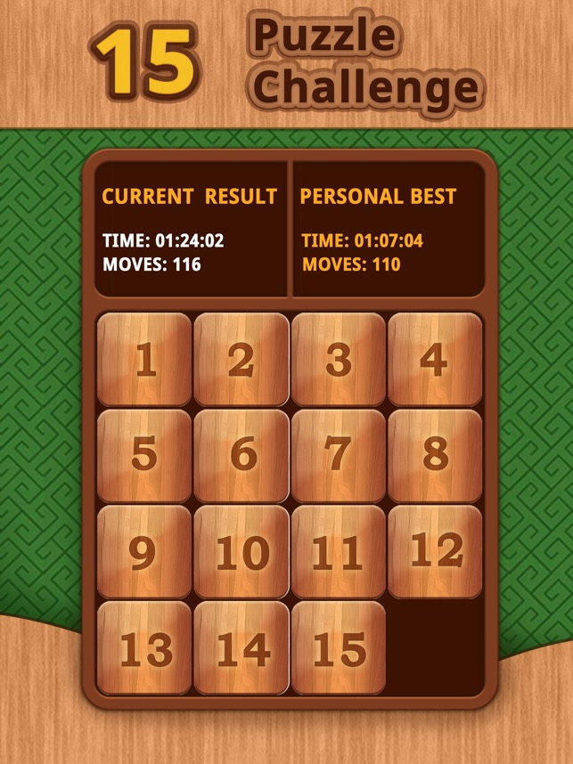
Implementation and software
Project#1 (5 points)

Slide 2
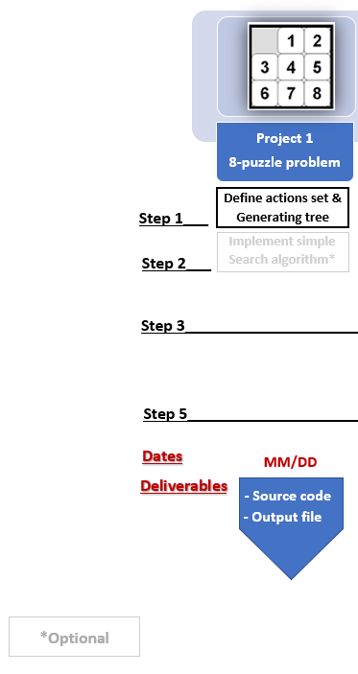
Project 1

Slide 3
Project -1 Description
Find all the possible states of the 15-Puzzle starting from the given initial state. Note that, the states should be unique (no repetitions).
From the initial state of the puzzle, use different moves in all the directions to generate new states, check the validity of the newly generated node.
Traverse the path as a tree and reach the final state
Programming in python is preferred.
Follow flow-chart for better intuition

Slide 4
Example

Slide 5
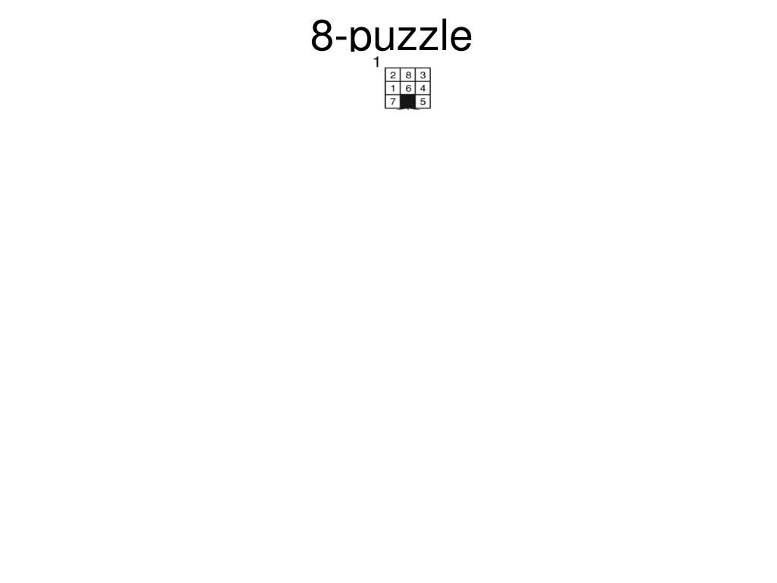

Slide 6
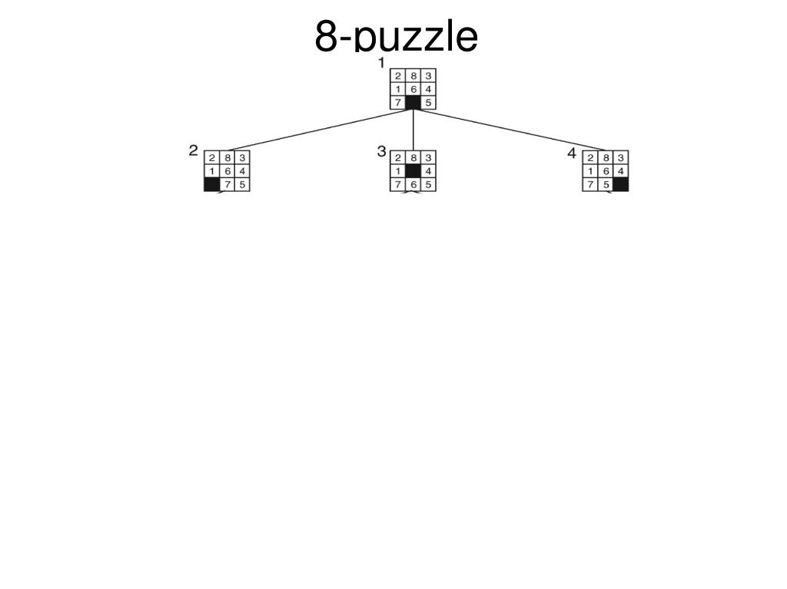

Slide 7
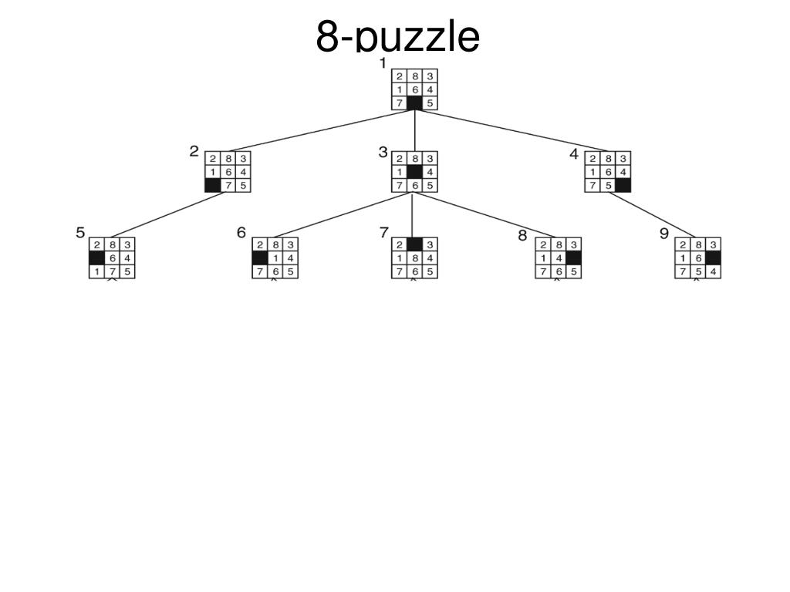

Slide 8
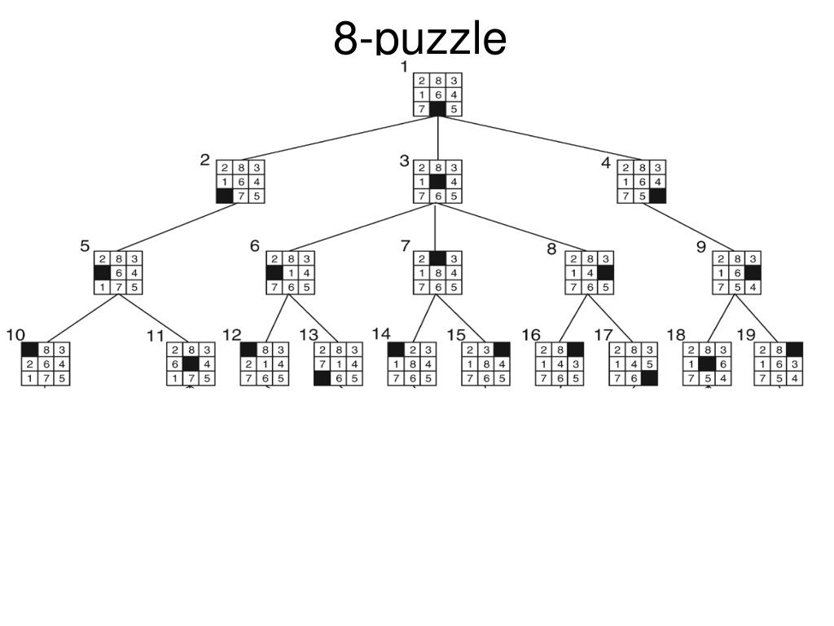

Slide 9
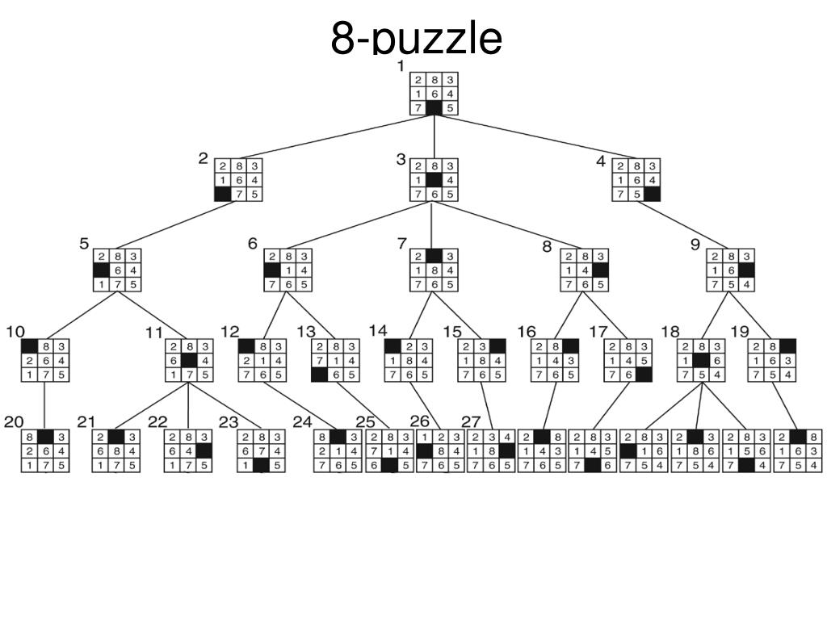

Slide 10
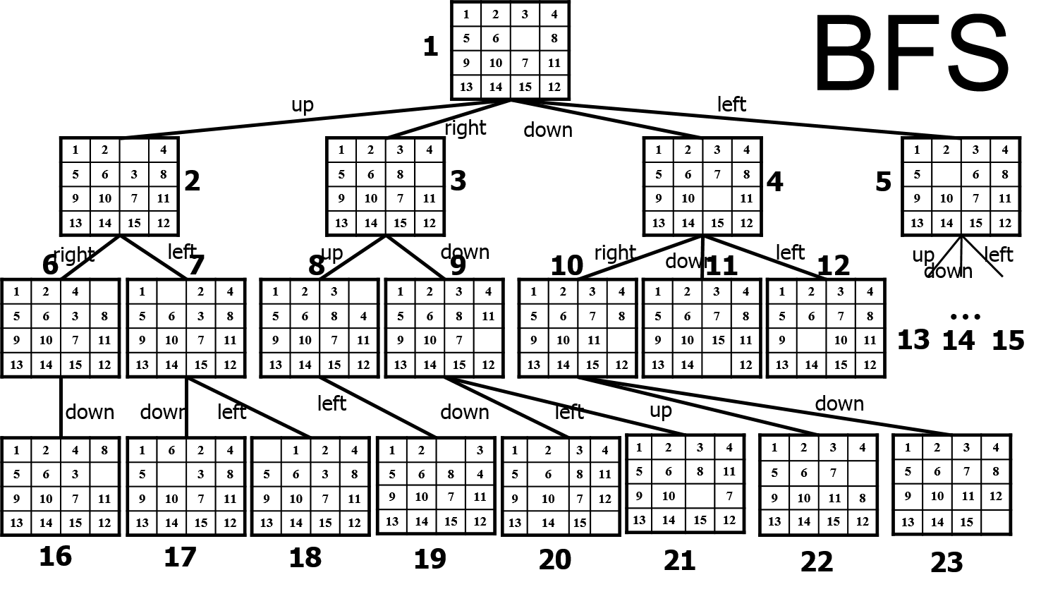

Slide 11
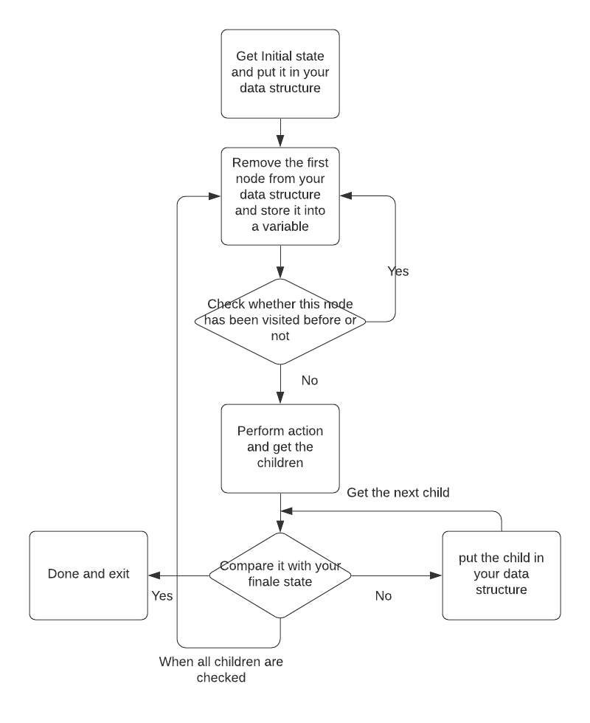
Flow chart
Start
Locate blank tile and

Slide 12
Suggested Parameter Names
HINT:
Information to be stored in the data structure for each node:
Node_State_i: The state of node i is represented by a 4 by 4 matrix, for example [ 1 2 3 4; 5 6 7 8; 9 10 11 12; 13 14 15 0].

Slide 13
1-First Step
You should first select a data structure type to save your generated nodes.
There are different types of data structure that could be used. The type of data structure is optional.
Hint: Read about stacks and queues

Slide 14

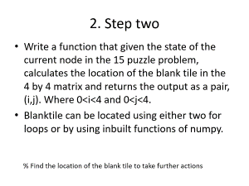
Data structure in PYTHON
Review the “list” and “dictionary” data structures for python in the following link
1) Learn Python - Full Course for Beginners [Tutorial] (Links to an external site.)
2) Learn Python - Full Course for Beginners [Tutorial] (Links to an external site.)
3) Learn Python - Full Course for Beginners [Tutorial]
4) https://www.linkedin.com/learning/learning-python-2 (Links to an external site.)
5) https://www.linkedin.com/learning/programming-foundations-data-structures-2 (Links to an external site.)
6) https://www.linkedin.com/learning/python-data-structures-stacks-queues-and-deques

Slide 15
2. Step two
Write a function that given the state of the current node in the 15 puzzle problem, calculates the location of the blank tile in the 4 by 4 matrix and returns the output as a pair, (i,j). Where 0<i<4 and 0<j<4.
Blanktile can be located using either two for loops or by using inbuilt functions of numpy.
% Find the location of the blank tile to take further actions

Slide 16
3. Step three
Write 4 subfunctions to move the blank tile in 4 different directions and store them in a list
[NewNode] = ActionMoveLeft(CurrentNode);
% Moves blank tile left, if possible
[NewNode] = ActionMoveRight(CurrentNode);
% Moves blank tile right, if possible
[NewNode] = ActionMoveUp(CurrentNode);
% Moves blank tile up, if possible
[NewNode] = ActionMoveDown(CurrentNode);
% Moves blank tile down, if possible

Slide 17
4. Step four
Append All the possible new nodes in a list
Follow the flowchart (optional) once done
Additional: Focus on checking the node to be explored with the visited list you maintain and if it is present do not repeat the actionset for that node.

Slide 18
Additional Notes
Parent child information is optional and not mandatory. No extra marks will be cut if the parent information is not stored with the current node.
Each test case will be allowed to run for a maximum of two hours to be considered for evaluation, i.e. given an initial node, the fifteen puzzle should be solved within this time.
Randomly 10 students will be selected who need to explain their code during TA office hours.

Slide 19
Due Date and Deliverables
Due date: 22nd Feb 11:59 pm .
Submit deliverables on Canvas & GitHub.
Deliverables:
Source code (Should be a python file)
Output textfile to be generated from the code: Nodes
A text file that explains how to run the program.
Folder Name (zip) : proj1_firstname_lastname

Slide 20
Additional Hint
Since it’s 15 puzzle for some test cases it might take a long time to reach the goal state thus it’s important to consider the code efficiency.
Increasing Efficiency:
Use a Good data structure (For Example: List, dictionary, Queue (Refer to the links)
Store Matrix as an integer or string which will help while comparing to different nodes.
While performing action read the integer/string and store it as a matrix for ease. (optional)

Slide 21
GitHub and README
GitHub
Well commented code
Frequent detailed commits, i.e. commits should have messages. For example - “ Added function to find the blank tile location”
The link (made public) should be uploaded as comments with your submission.
ReadMe
Instructions to run the code, step by step.
Explicitly mention the libraries used in your code

Slide 22
Output textfile to be generated from the code
Textfile 1:
Name: nodePath.txt
The elements are being stored column-wise, i.e. for this state 1 5 9 13 2 6 10 14 3 7 11 15 4 8 12 0 , the fifteen- puzzle state is
1 2 3 4
5 6 7 8
9 10 11 12
13 14 15 0
The order of the states should be from start node to the goal node.

